Slide 1
URL for presentation: https://youtu.be/9DZisH9mOhI

Slide 2
Chuyang Li (19cl98@queensu.ca): <leader>, Chuyang Li gave the report a brief start by doing the abstract and introduction and overview. Give the idea of the new subsystem
Qintao Zhang (18qz28@queensu.ca): Qintao Zhang assists to analyze software architecture and draw sequence diagram as well as box-arrow diagram.
Anthony Zhou (18zz172@queensu.ca) - <slide preparation>, Anthony Zhou analyze software architecture and draw sequence diagram and box-arrow diagram
Wenchu Xiao (19wx25@queensu.ca): Wenchu xiao analyze software architecture and draw sequence diagram and box-arrow diagram.
Chang Xu (18cx19@queensu.ca): <presenting>, Chang Xu did the architectural style analysis and texting section description for the report, she also contributed to the graphical design of the transaction use case diagram.
Xiaoran Zhang(19xz64@queensu.ca): Allen Zhang is responsible for preparing the report, completing an in-depth analysis of Bitcoin's development team, the Bitcoin core system's evolution, concurrency processing, lessons and limitations.

Slide 3
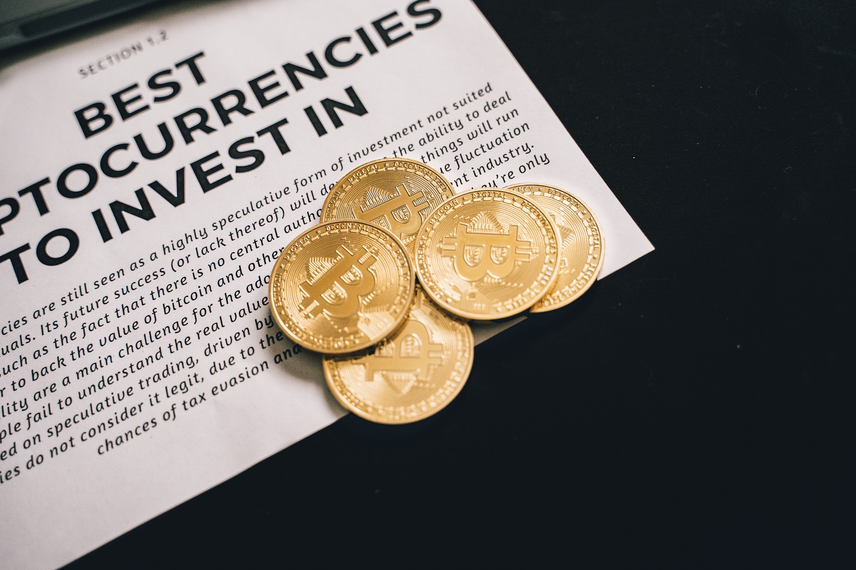
Bitcoin Core
Group 6 Presented by Anthony Zhou, Chang Xu

Slide 4
Privacy Mode
minimize the chances of third-party tracking
Safer
more private

Slide 5
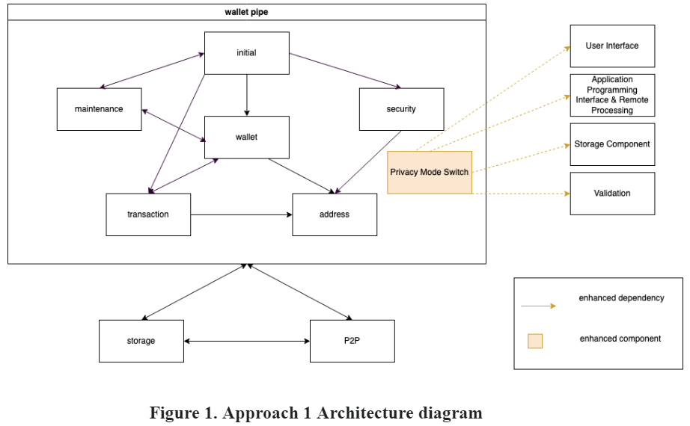
Approach 1

Slide 6
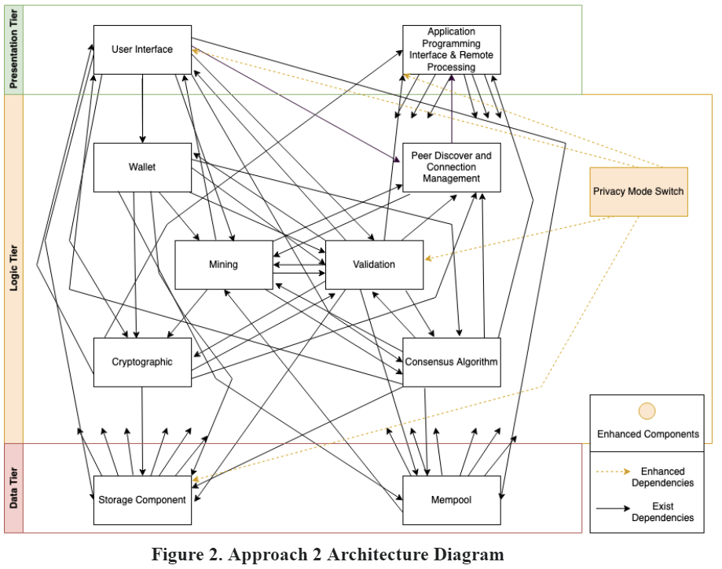
Approach 2

Slide 7
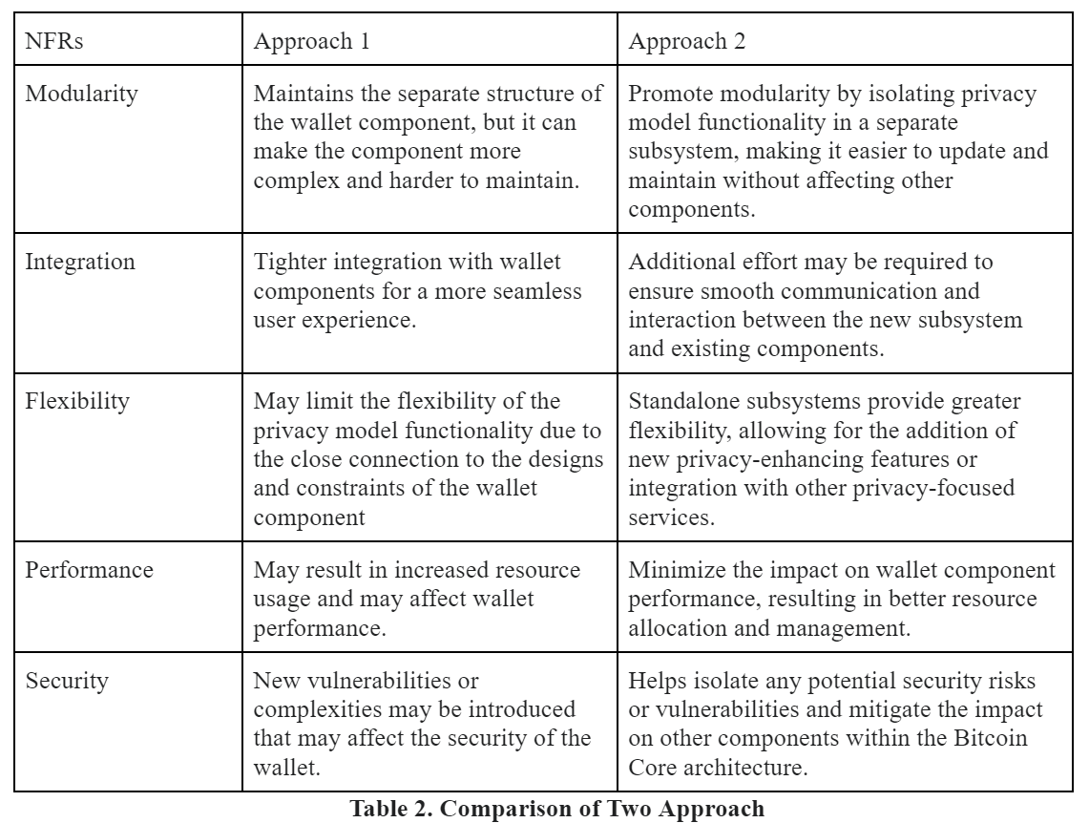
SAAM Analysis
Stakeholder
- User
- Developer
- Investor

Slide 8
Impacted Subsystem
1. UI
2. API
3. Storage
4. Validation

Slide 9
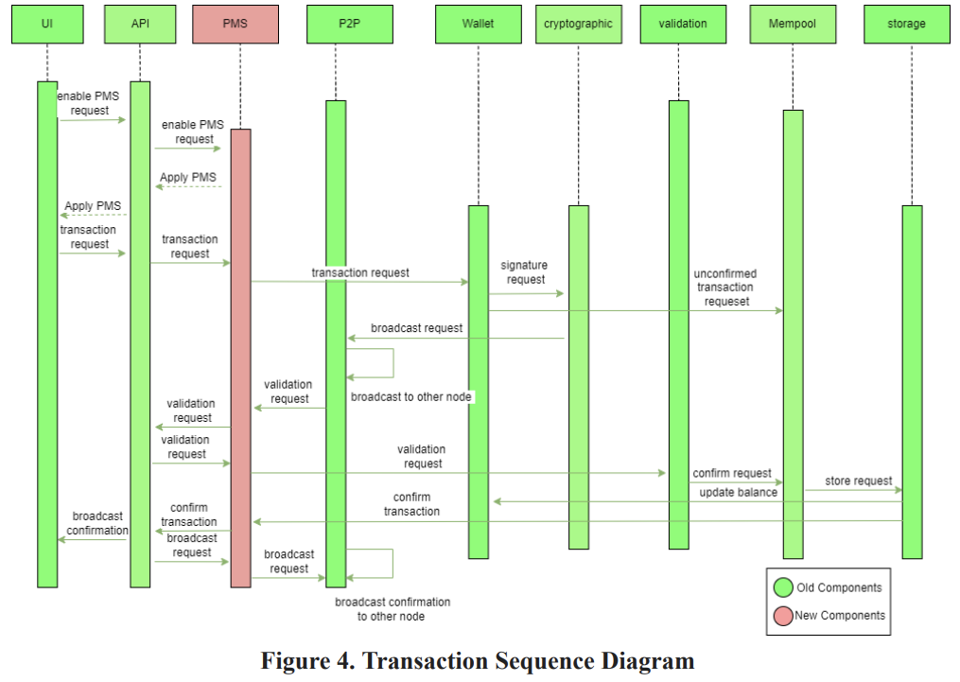
Use case: Transaction

Slide 10

Risk, limitation and Concurrency
1. network's overall integrity and transparency
2. cover for illegal activities
3. Parallel with any subsystem

Slide 11
Testing and Lesson Learned
Unit testing, integration testing, and system testing
Different implementation strategies
3. Significance of encouraging transparent

Slide 12

Thank you !

